Slide 1
Price of Poverty
Graham Center
Community Outreach Research Team
College of Medicine :: University of Florida
Dr. Nancy Hardt, MD
Mona Sayedul Huq, MS, CHES

Slide 2
Outline
Gini index
Minimum wage
Living wage
Incomes in Alachua County
Education of children in Alachua County

Slide 3
Wealth= Health
Education=Wealth
Therefore
Education= Health

Slide 4
Which of the following is NOT in the top 5 for income inequality among 300 US cities?
Gainesville
Miami
Atlanta
New Orleans
Dallas

Slide 5
Which of the following is NOT in the top 5 for income inequality among 300 US cities?
Gainesville
Miami
Atlanta
New Orleans
Dallas

Slide 6
2014 Gini Index-ranked the 50 cities in the US Cities with the highest income inequality
Bloomberg visual data 2014 GINI coefficient US cities
#1 Atlanta
#2 New Orleans
#3 Miami
#4 Jackson, MS
#5 Gainesville (Median income $28,900 highest quintile has 58% of household income)
#41 Philadelphia
#45 Memphis, TN

Slide 7
INCOMEAlachua County
Federal Poverty Level $20,000/Yr/Family Of 4 ($9.83/Hr)
Median Income $42,818 ($21/Hr)
Federal Minimum Wage $7.25
Florida Minimum Wage $7.93
Alachua County Living Wage $9.27/Person, $19.22 For One Adult Plus One Child

Slide 8
Alachua County Living Wage WAGE MONTHLY EXPENSES, FAMILY OF 4
Food $754
Child Care (X2) $1094
Medical Care $364 (X12=4368)
Housing $742
Transportation $940
Other $781
Annual Income Before Taxes $56,614
Living wage for family of 3 is $48,604
Median Household Income Fl $42,865 Males, $36,351 Females
Median Household income Alachua County $29,000

Slide 9
Alachua County wages below living wageHOURLY WAGES (BELOW LIVINGAGE)
Sales $12.43
Installation, Maint, Repair $17.53
Construction $16.18
Farming $8.86
Cleaning And Grounds Work $9.77
Office And Administrative Support $13.65
Security $16.40
Community And Social Services $17.83

Slide 10
Alachua County wages above living wageOURLY WAGES, LIVING WAGE
Management $43.41
Business Operations $25.89
Computer/Math $30.49
Architecture $29.94
Life Science $24.25
Legal $29.29

Slide 11
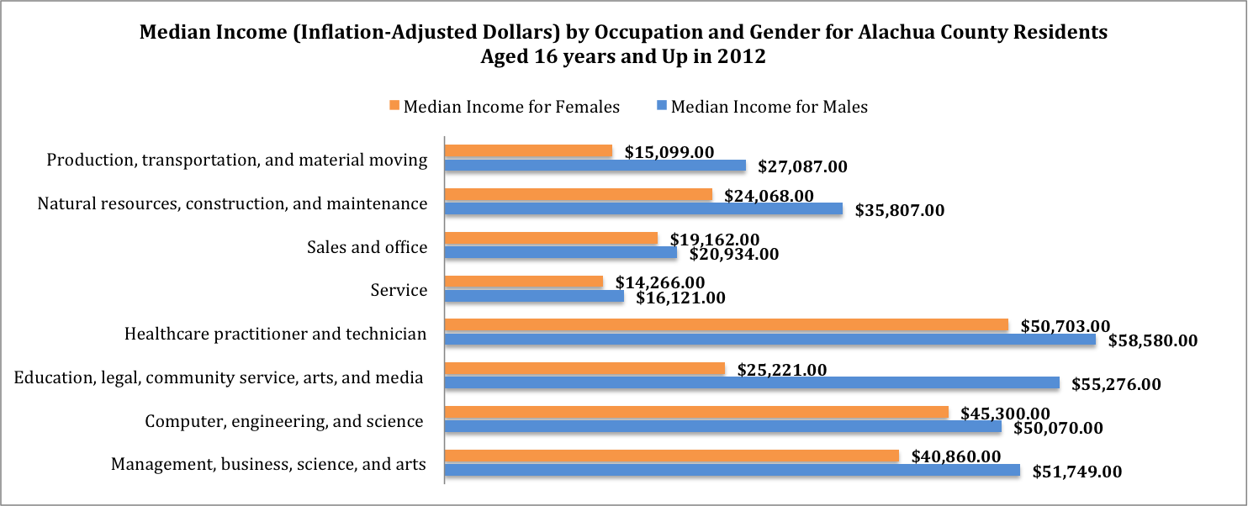

Slide 12
How many reproductive-aged women gave birth in the last 12 months?
A. 50% or 36, 503
B. 25% or 18, 256
C.12% or 8760
D. 2.5% or 1825

Slide 13
What percent of reproductive-aged women gave birth in the last 12 months?
A. 50% or 36, 503
B. 25% or 18, 256
C.12% or 8760
D. 2.5% or 1825

Slide 14
Of the women who gave birth, what percent of these women were single?
A. 60%
B. 45%
C. 30%
D. 15%

Slide 15
Of the women who gave birth, what percent of these women were single?
A. 60%
B. 45%
C. 30%
D. 15%

Slide 16
Of the women who gave birth, what percent receive cash supports (does not include Medicaid, WIC, food stamps/SNAP or housing subsidies)?
A. 90%
B. 45%
C. 23%
D. 5%

Slide 17
Of the women who gave birth, what percent receive cash supports (does not include Medicaid, WIC, food stamps/SNAP or housing subsidies)?
Less than 100 Women
A. 90%
B. 45%
C. 23%
D. 5%

Slide 18
How much cash assistance do single mothers get and for how long?
$600/month till youngest child is 18
$300/month till youngest child is 18
$300/month till youngest child is 5
$300/month for 5 years in her lifetime

Slide 19
How much cash assistance do single mothers get and for how long?
$600/month till youngest child is 18
$300/month till youngest child is 18
$300/month till youngest child is 5
$300/month for 5 years in mother’s lifetime, no matter how many children she has

Slide 20
What are the requirements for single mothers to get cash assistance?
Be a stay at home mom for the first five years, then get a job or go to school
Be a stay at home mom for the first six months then get a job
Be a stay at home mom till the children are 18 and then get a job

Slide 21
What are the requirements for single mothers to get cash assistance?
Be a stay at home mom for the first five years, then get a job or go to school
Be a stay at home mom for the first six months then get a job
Be a stay at home till the children are 18 and then get a job

Slide 22
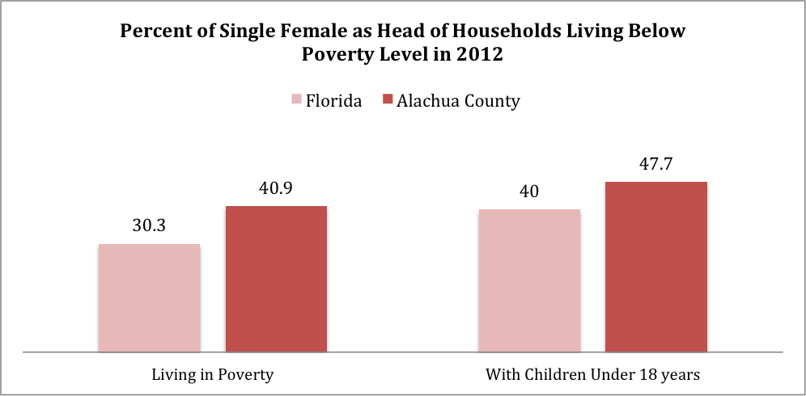

Slide 23
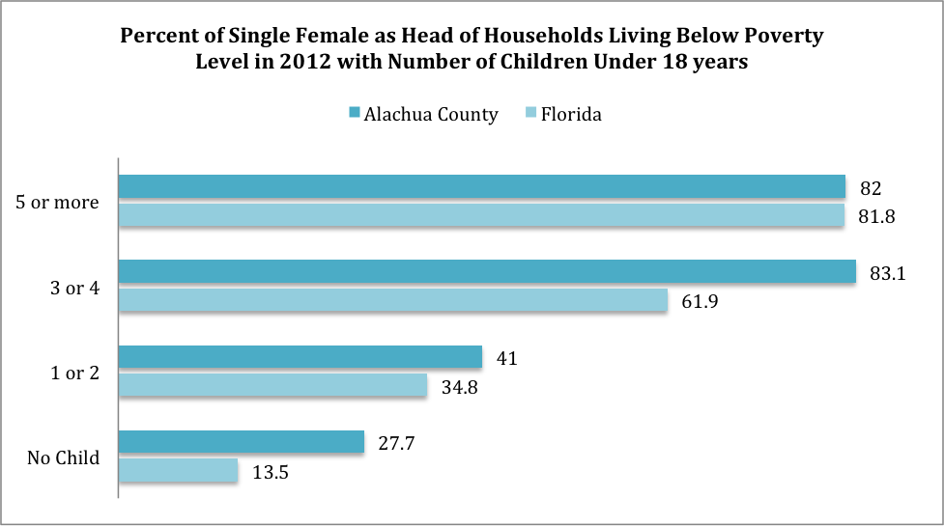

Slide 24
C
ACA
If I make $16,000, I can buy a bronze PPO plan for $3 a month, a $5000 deductible, then $35 co pay at every doctor or specialist visit. Drugs I get a 75% discount after my deductible is met.
If I make $15,000 I pay $325 a month, have a $2000 deductible and pay $30 at every doctor visit. Drugs are $15 for a generic

Slide 26
How do our high school graduation rates compare with the rest of the state?
A. We do better: 93% vs 81%
B. We do better: 81% vs 78%
C. We do worse: 81% vs 78%
D. We do worse: 66% vs 68%

Slide 27
How do our high school graduation rates compare with the rest of the state?
Answer was D in 2000!
A. We do better: 93% vs 81%
B. We do better: 81% vs 78%
C. We do worse: 81% vs 78%
D. We do worse: 66% vs 68%

Slide 28
What percent of students in Alachua County Public Schools are not performing at grade level?
A. 3%
B. 10%
C. 25%
D. 80%

Slide 29
What percent of students in Alachua County Public Schools are not performing at grade level?
A. 3%
B. 10%
C. 25%
D. 80%

Slide 30
Why LSP
Communities are made up of neighborhoods;
Neighborhoods are made up of families who share/express common values;
One of the ways that families express their values is through their patters of consumption; and
Family consumption patterns are tracked/monitored by retailers and social scientists.

Slide 31
Identifying LSP Performance Groups
  Identifying Performance Groups
    COLLAPSE LSP categories into 3 groups that BROADLY define each community
    Organize LSP categories into 3 meaningful groups based on math and reading achievement scores for each district.
      HIGHEST MATH AND READING ACHIEVEMENT OBSERVED IN HIGHEST SES LSP GROUP
      LOWEST MATH AND READING ACHIEVEMENT OBSERVED IN LOWEST SES LSP GROUP

Slide 35
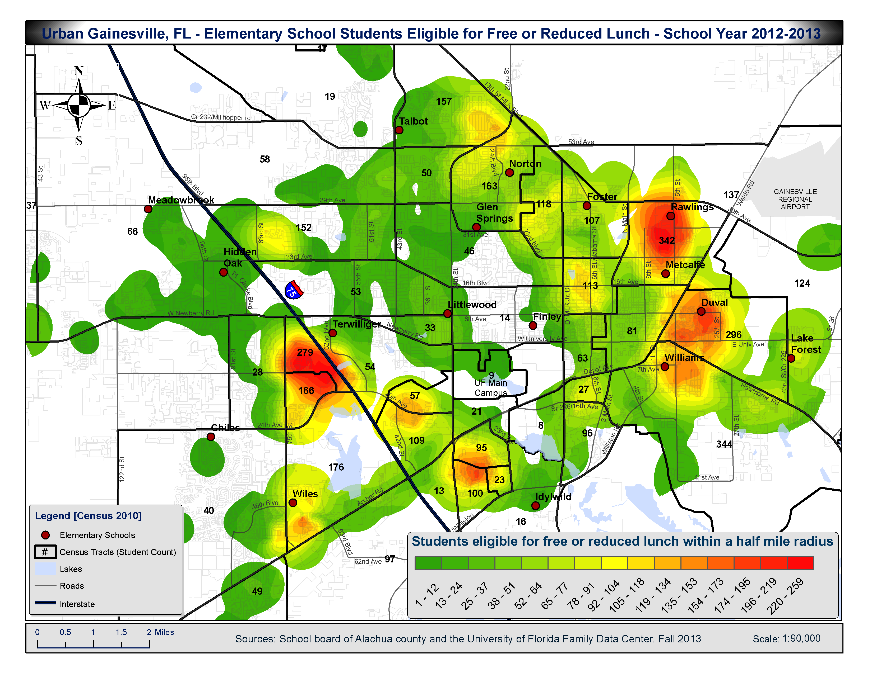
Percent of Students Receiving Free/Reduced Lunch by School (2011 - 2012):
Chiles - 40.36%
Duval - 88.97%
Finley - 52.04%
Foster - 59.12%
Glen Springs - 40.09%
Hidden Oak - 15.01%
Idylwild - 81.91%
Lake Forest - 92.07%
Littlewood - 54.02%
Metcalfe - 90.66%
Norton - 53.18%
Rawlings - 93.15%
Talbot - 21.35%
Terwilliger - 80.7%
Wiles - 100%
Williams - 68.02%

Slide 36
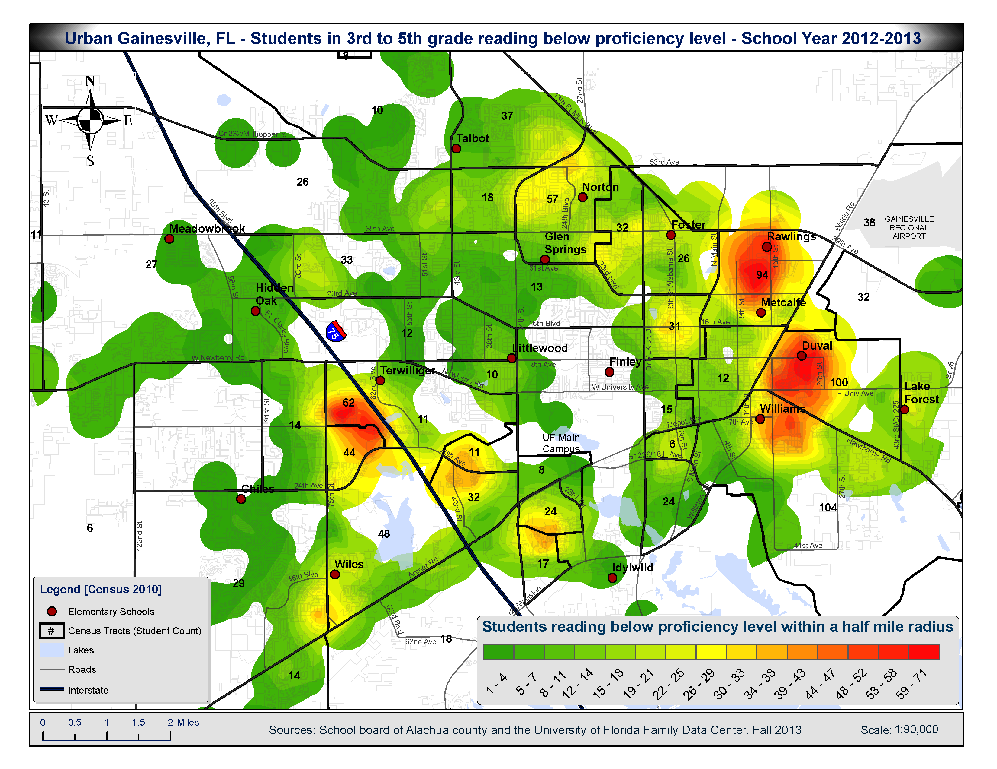

Slide 37
How many licensed child care centers are there in Alachua County?
A. 25
B. 50
C. 100
D. 400

Slide 38
How many licensed child care centers are there in Alachua County?
A. 25
B. 50
C. 100
D. 400 (394 exactly)

Slide 39
How many licensed child care centers are in SWAG (approximately 500 children aged 0-3 year olds)?
A. 0
B. 2
C. 10
D. 25

Slide 40
How many licensed child care centers are in SWAG (approximately 500 children aged 0-3 year olds)?
A. 0
B. 2
C. 10
D. 25

Slide 41
Subsidized early childhood education in Gainesville
Waiting list for Early Learning Coalition, approximately 600 children

Slide 42
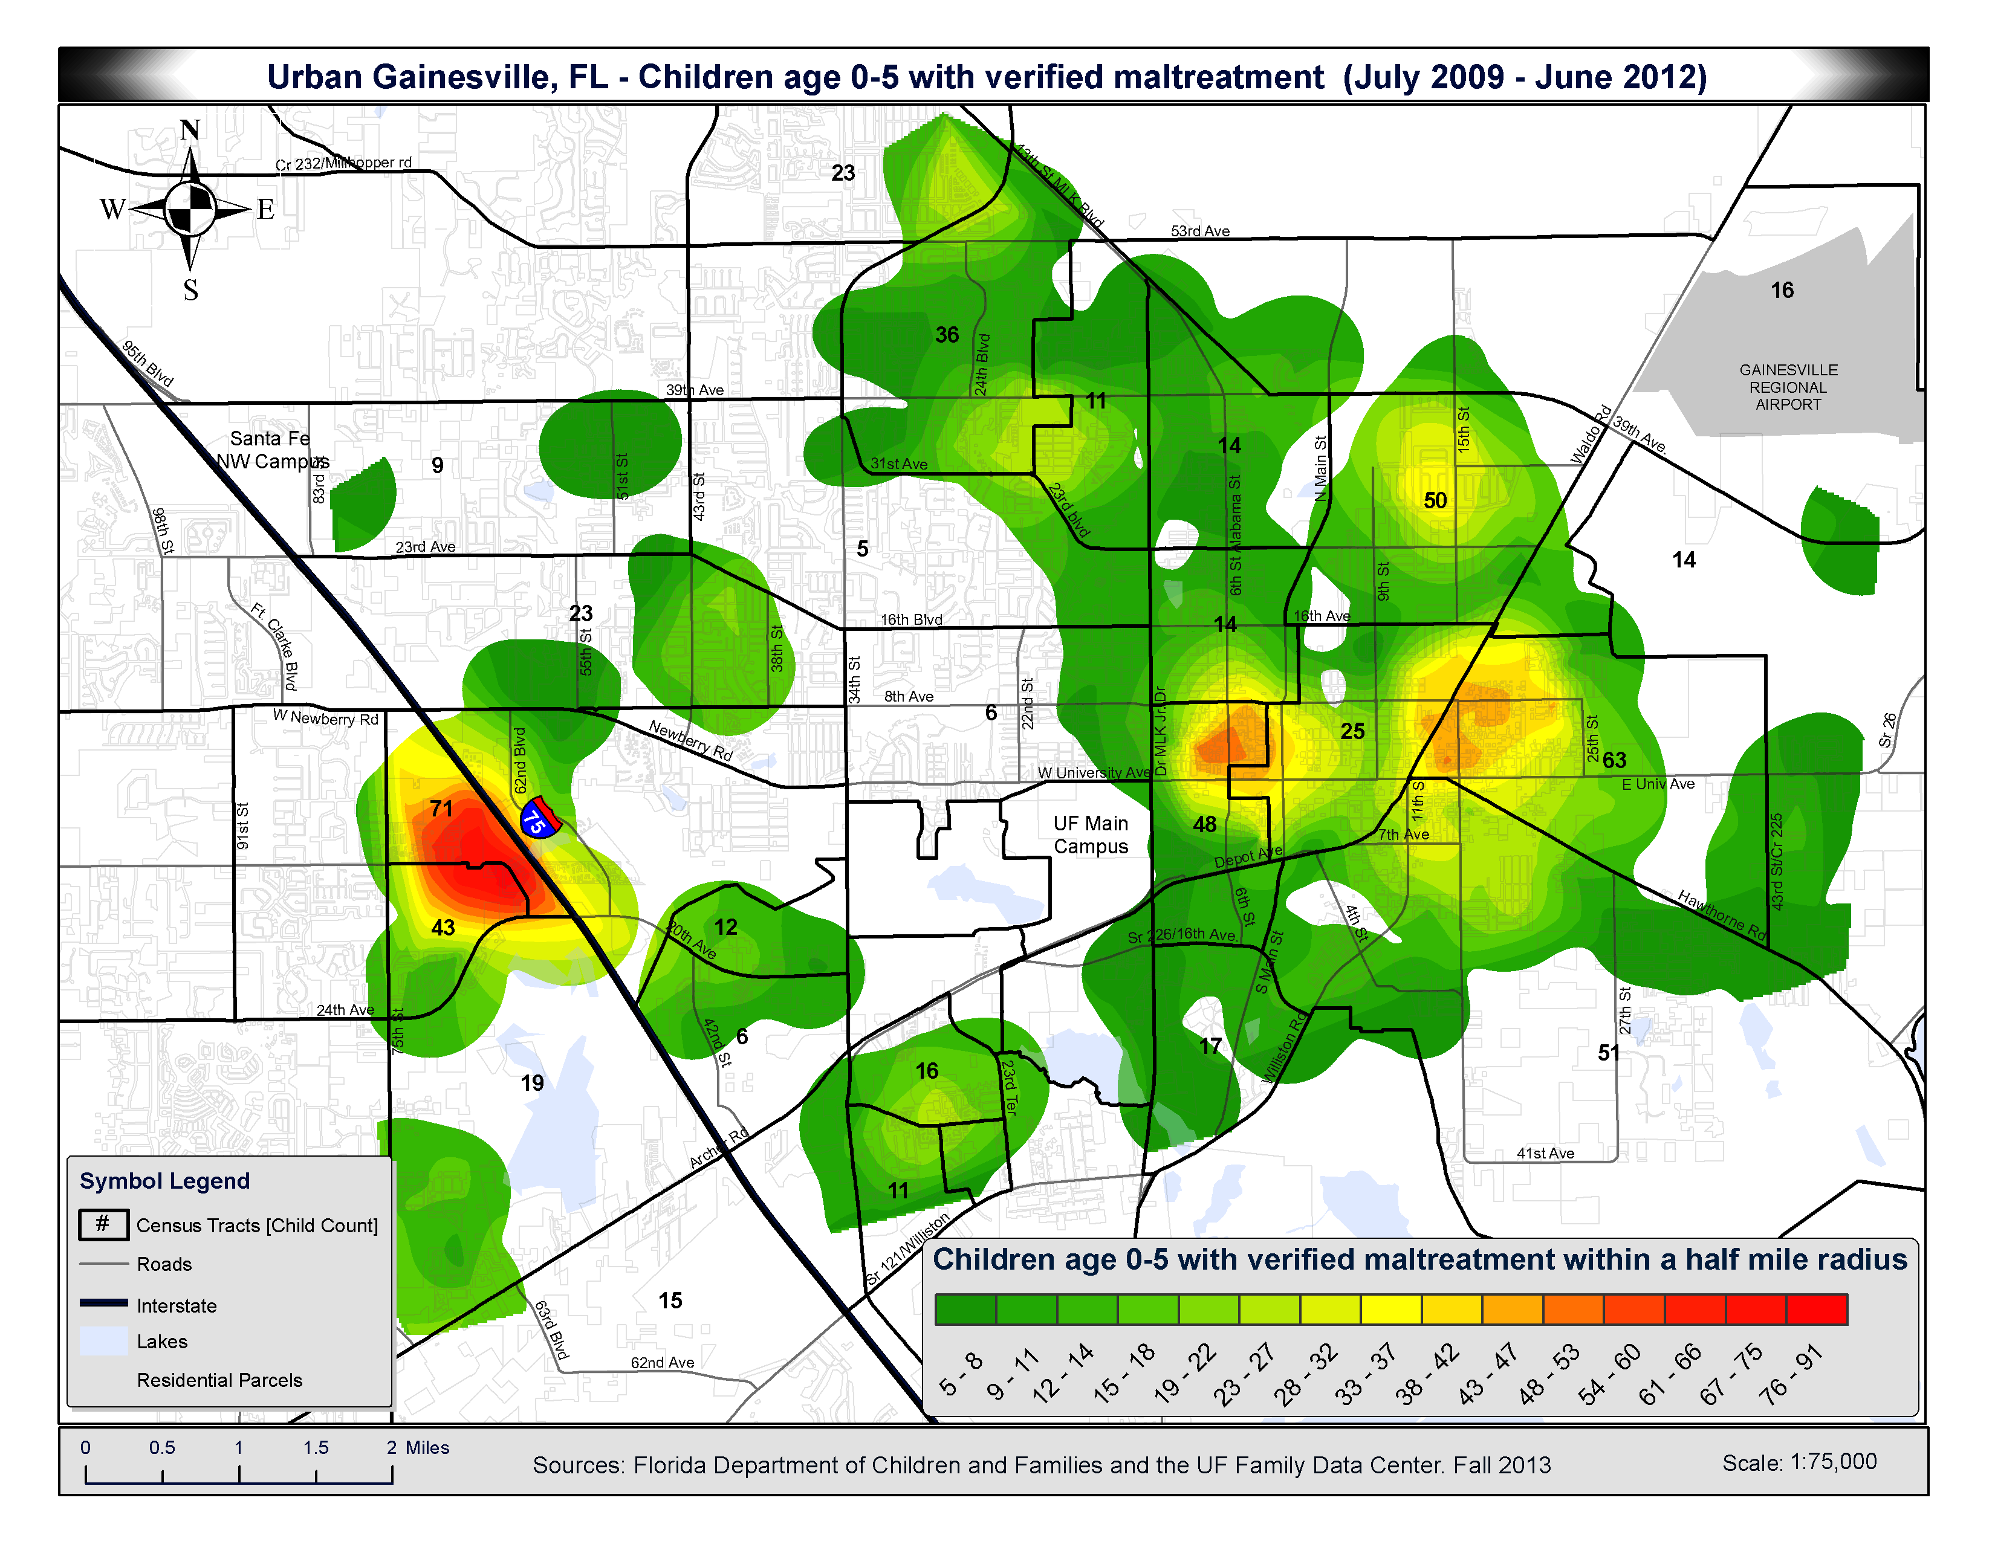

Slide 43
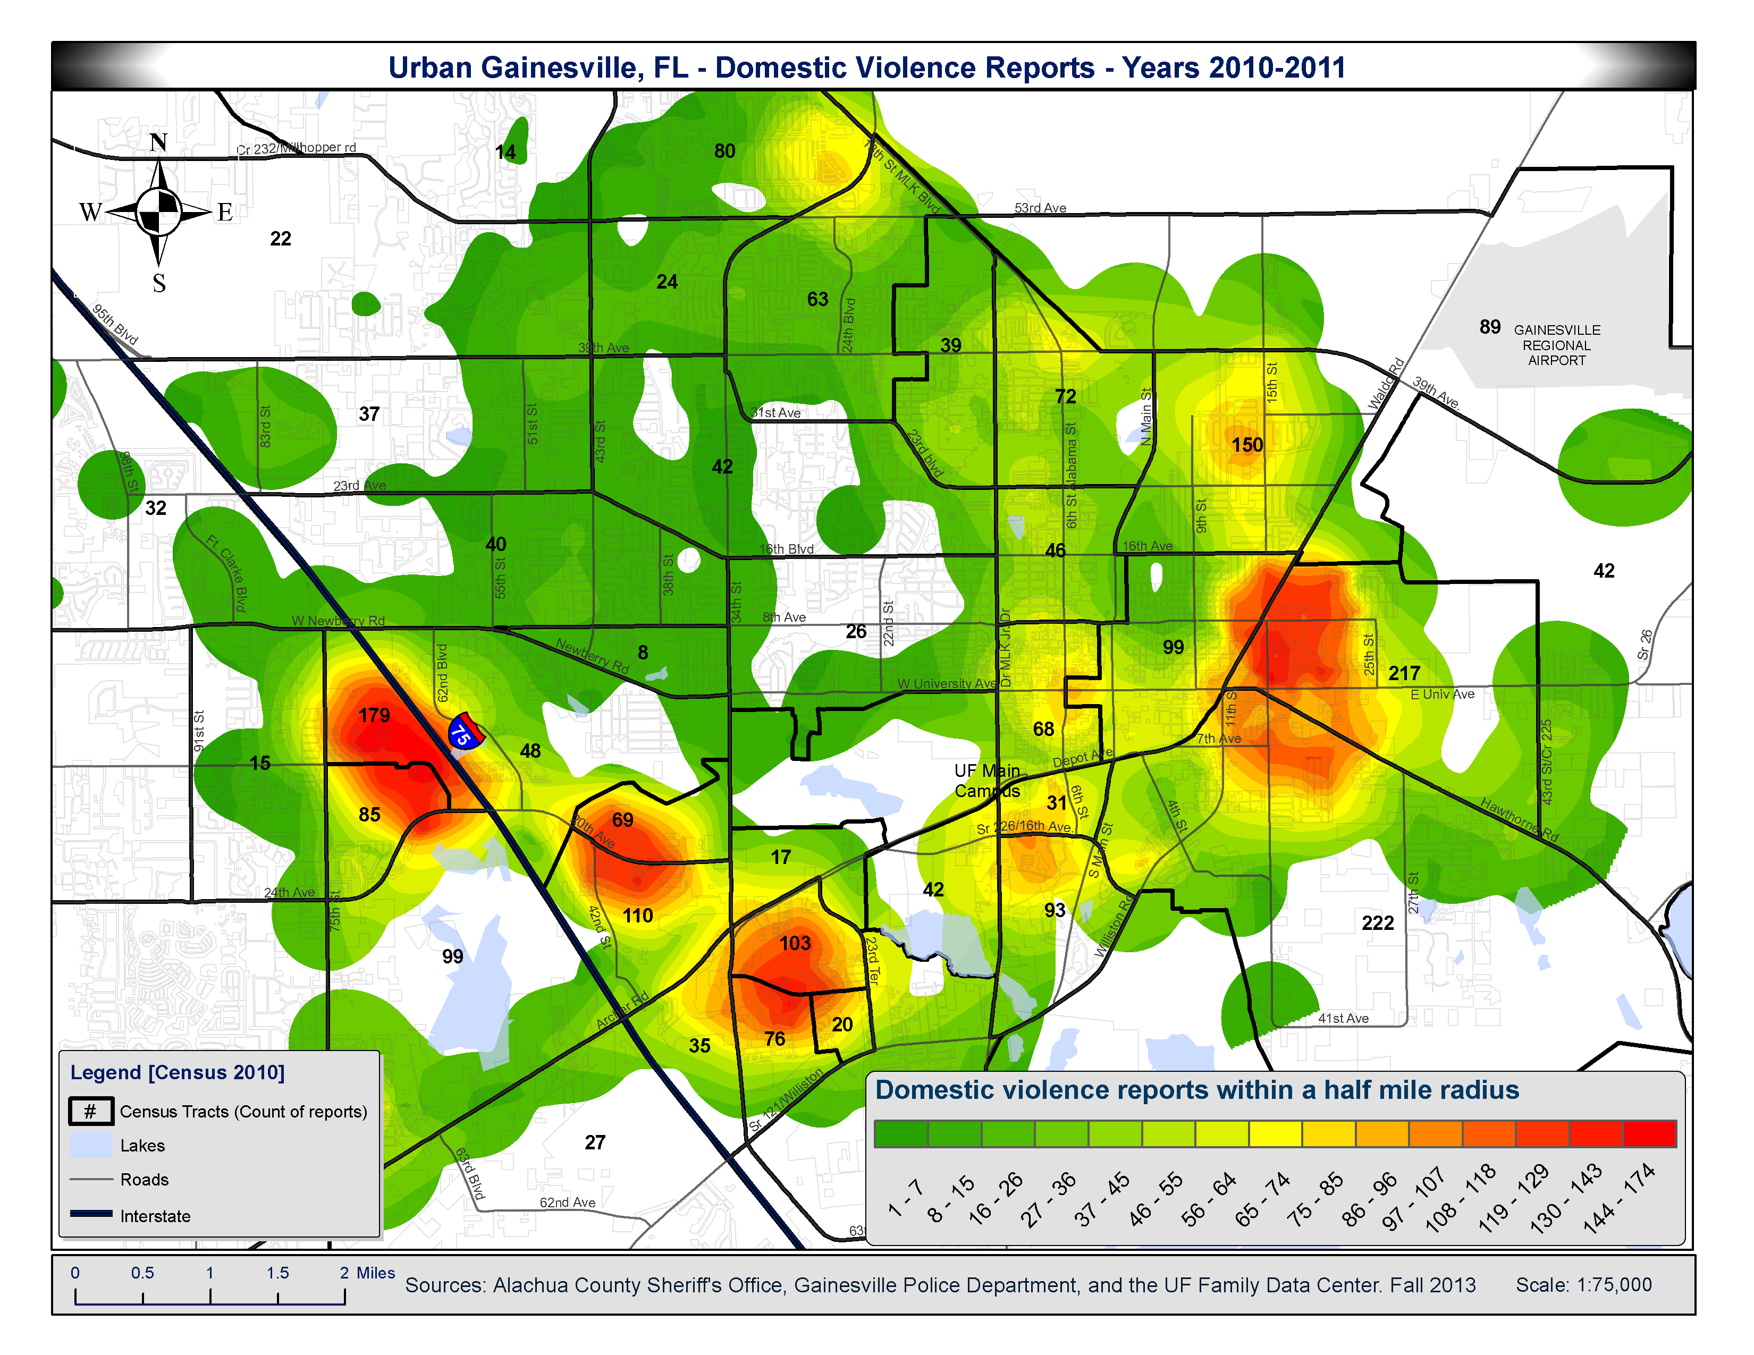

Slide 44
To improve high school graduation rates, we need to begin at …
A) Eighth grade, to prepare for math standardized testing
B) Fourth grade, when reading comprehension is acquired
C) First grade, when basic reading skills are acquired
D) Kindergarten, when social emotional readiness is acquired
E) Between 0-3 years of age

Slide 45
To improve high school graduation rates, we need to begin at …
A) Eighth grade, to prepare for math standardized testing
B) Fourth grade, when reading comprehension is acquired
C) First grade, when basic reading skills are acquired
D) Kindergarten, when social emotional readiness is acquired
E) Between 0-3 years of age

Slide 46


Slide 47
RERE
SUMMARY
1) Much evidence indicates that there is disproportionate poverty in Alachua County compared to the state and the nation
2) To reduce educational disadvantage we need to start before Kindergarten
3) For long term gain across the lifespan, invest in teens (one sexual experience away from parenthood) and early childhood education

Slide 48
Thank You

